Slide 1
DS PROJECT
By:Bhargava Bodas -054
Chandini Velilani -057
Apoorva Bhat -041

Slide 2


DESCRIPTION
The implementation of the monopoly game where a number of players compete, indulge in the buying/selling of properties.

Slide 3
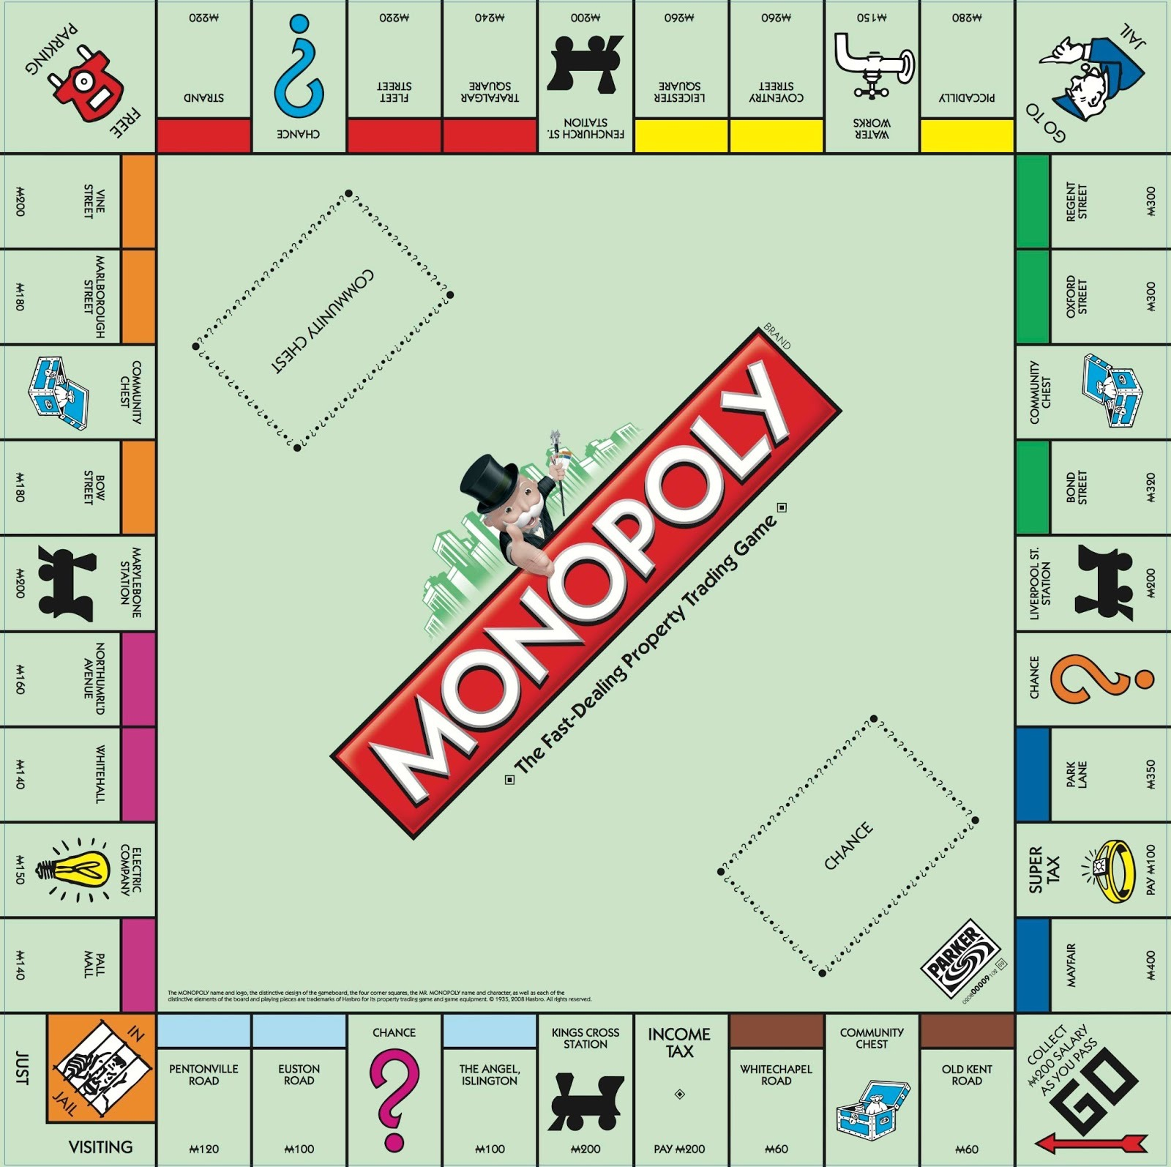
MONOPOLY BOARD

Slide 4
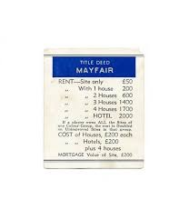
SAMPLE TITLE DEED

Slide 5
TOOLS USED
GUI -ECLIPSE
GRAPHICS -SWING,AWT
EDITING-PHOTOSHOP.

Slide 6
GAME RULES
The players start at the Go tile of the game. A typical turn begins with the rolling of the dice and advancing their piece clockwise around the board the corresponding number of squares
Initially every player is given $1500;
If the player lands on a property , he/she has the option of buying the property in the case when the property is not already bought by any player but, if not so, the player should pay the determined rent to the owner.
Construction of buildings can be done on these which will increase the rent for an arriving player
If a player lands on Chance or Community Chest, they draw the top card from the respective pile and obey its instructions
A player will land in jail if they land on "Go to Jail
A player who lands or passes the Go space collects $200 (unless they automatically go to jail).
Players who land on either Income Tax or Luxury Tax pay the indicated amount to the bank

Slide 7
DATA STRUCTURES USED
1. The board is implemented as a circular linked list of Nodes
The Node class contains the following attributes;
String name
Node next: a link to the next Node
Methods;
visit(Player p) : called when a player visits the node
Additionally, the nodes are also stored as a map collection with the name of the node being the key

Slide 8
Data Structures Used:
Board: Circular Linked List
HashMap : maps Nodes to place
2.CommunityChestCards & ChanceCards :Circular Linked List.
3.Players:ArrayList
4.GUI elements

Slide 9
NODES
The following classes inherit from the Node class
CityNode
ChanceNode
CommunityChestNode
specific cards implemented using Queue
UtilityNode
Tax Node

Slide 10
CITYNODE
Attributes:
String color
int price
int renthouse[]
int renthotel
int housecost
int hotelcost
int mortgage_value
Player owner
int no_houses
int no_hotels

Slide 11
PLAYERS
The players: implemented using ArrayList;
HashMap:
Node currentlocation;
String name;
Player next;

Slide 12
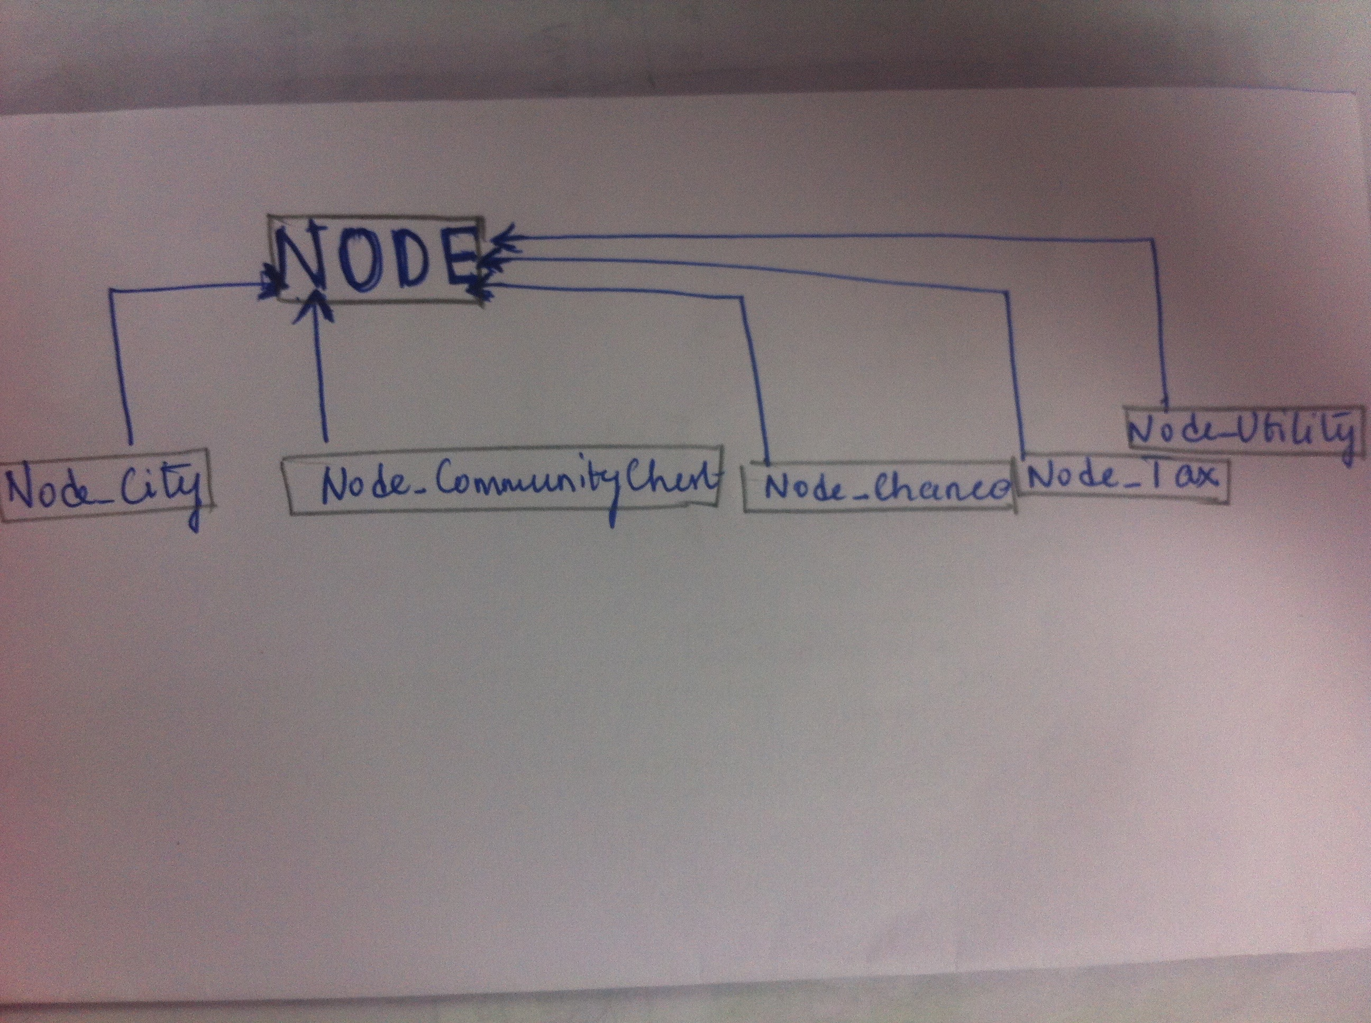
Inheritance Diagram!

Slide 13
VICTORY CONDITIONS
The victory conditions may be;
The player with highest amount and property after a predetermined amount of time wins.
The game goes on till all but one player goes bankrupt and the last player standing is the winner
Any other customized conditions

Slide 14
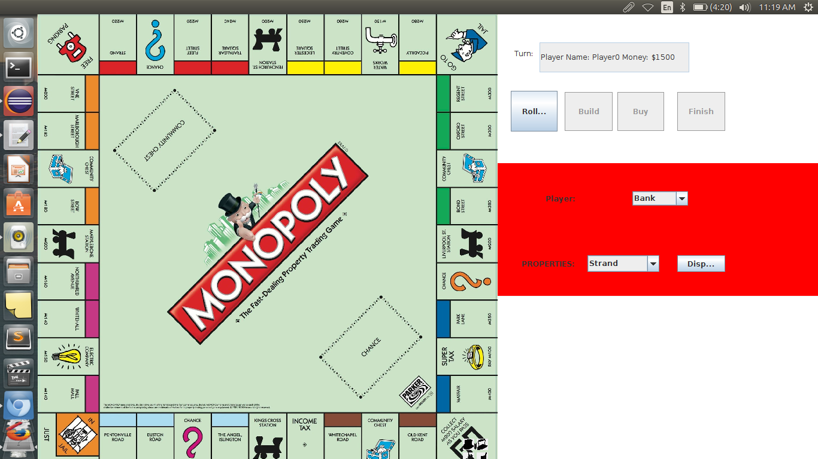
SCREENSHOTS

Slide 15
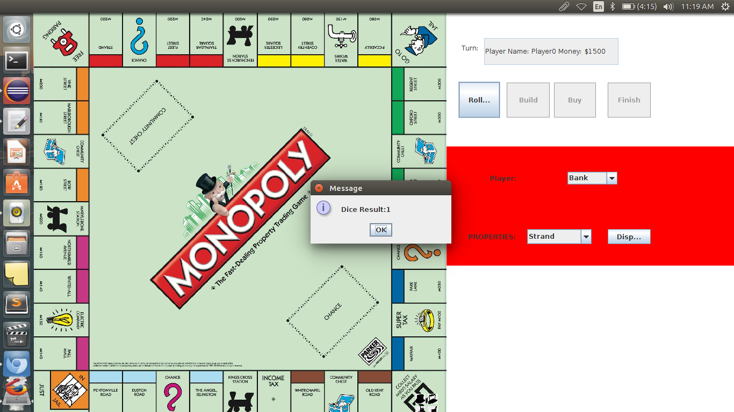

Slide 16
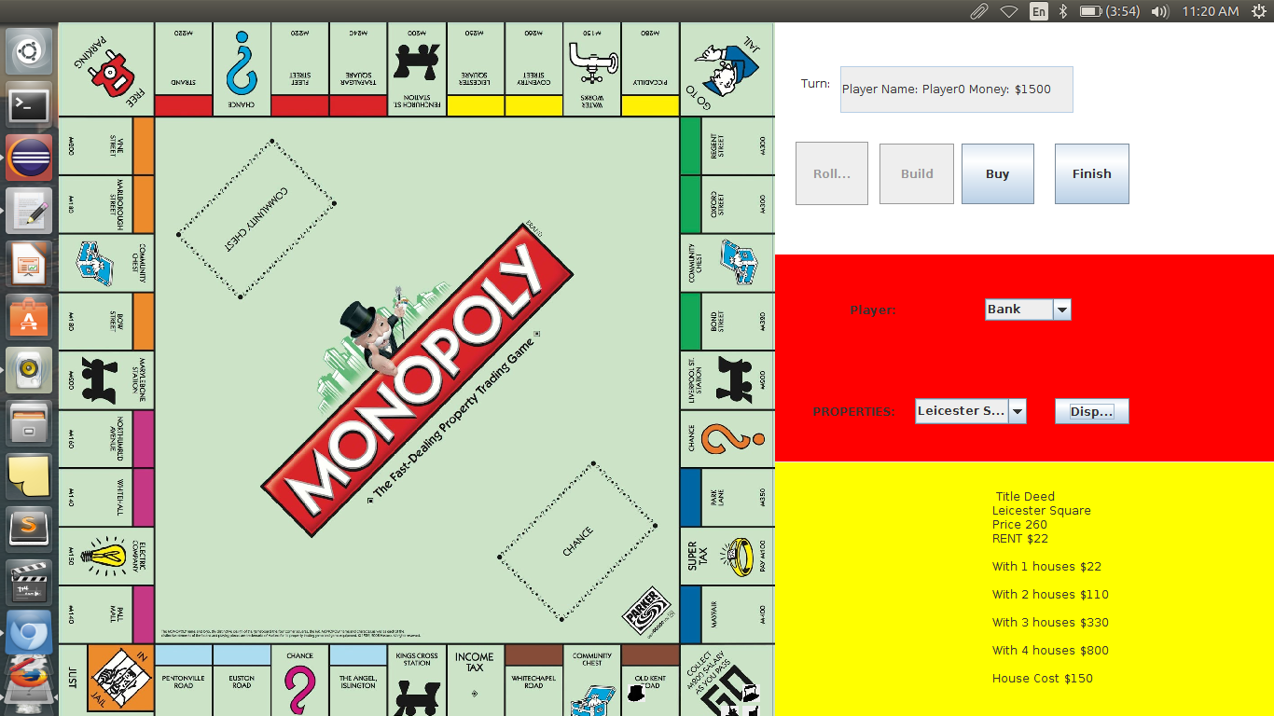

Slide 17
Limitations & Improvements.
1.Restricted Players to only 4.
2.Couldn’t handle building hotels.
3.Jail, Go to Jail not yet implemented
4. Victory Conditions not set

Slide 18
Conclusion:Things Learnt
1.Implement DataStructures in RealLife.
2.Collections like HashMap,ArrayList implementations.
3.Use Eclipse IDE.
4.Design GUI.
5. Team Work,Coordination ,TimeManagement.

Slide 19
Encountered a general programming mistake when we tried to create a Board object inside a CommunityChest Node
The CommunityChest Node was being created in the Board class This lead to a stackoverlflow in the execution

